Slide 1
Topics covered:
Solar spectra
Latitude and longitude
Seasonal variations, daily variation
Solar window
Declination angle, hour angle

Slide 2
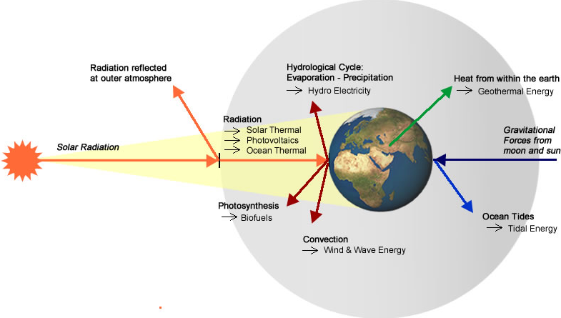

Slide 3
Definitions:
Solar radiation: Energy radiated by sun
Solar irradiation: Radiated energy received on earth surface.
Solar insolation: Solar radiation received on a flat horizontal surface on earth.
Solar constant: Solar power received on unit area of surface normal to sun rays in the space outside the earth’s atmosphere at a mean distance between sun and earth

Slide 4
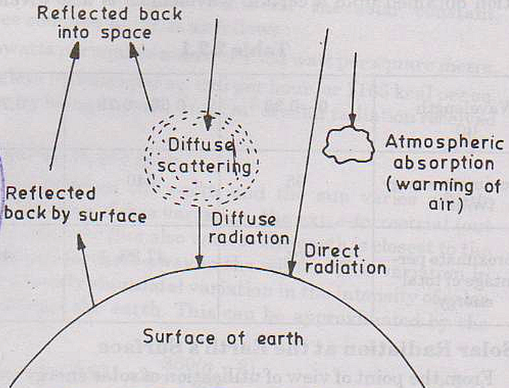
Sun radiation

Slide 5
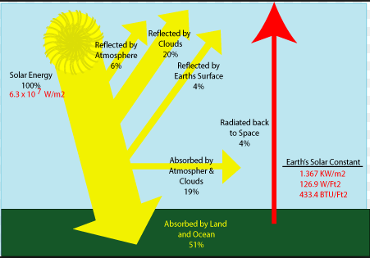

Slide 6
SOLAR SPECTRUM
Solar radiation is radiant energy emitted by the sun, particularly electromagnetic energy.
About half of the radiation is in the visible short-wave part of the electromagnetic spectrum.
The other half is mostly in the near-infrared part, with some in the ultraviolet part of the spectrum.

Slide 7
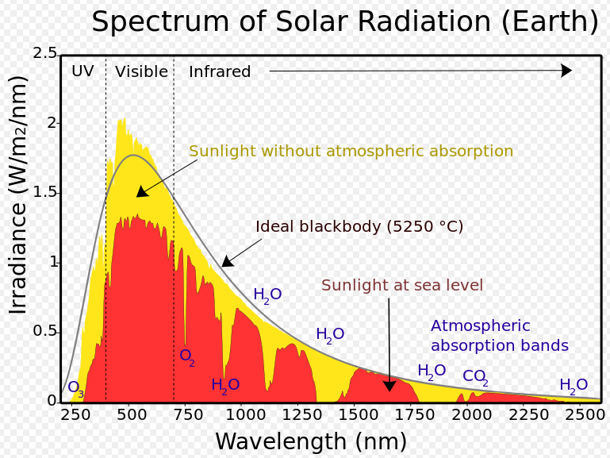
SOLAR SPECTRA

Slide 8
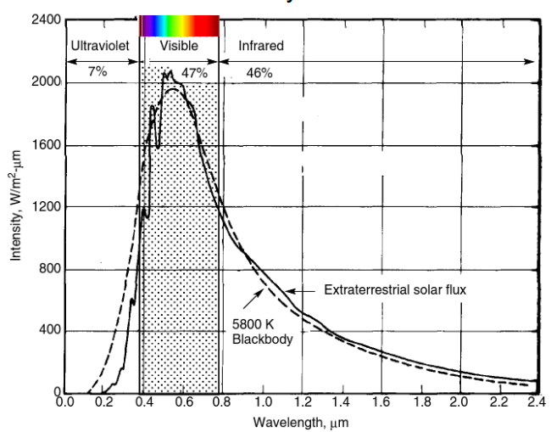
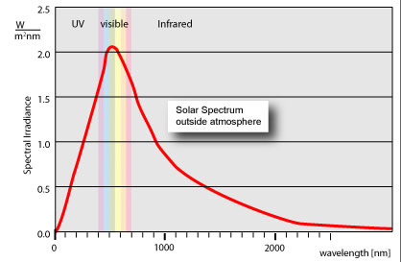
Solar spectrum

Slide 9
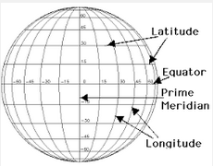
Lines of Longitude: Imaginary lines on surface of the earth between the north pole and south pole. Parallels of Latitude: Imaginary lines on surface of earth, parallel to the equatorial lines.

Slide 10
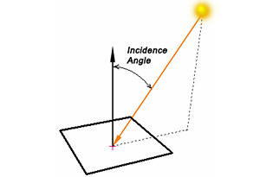
Angle of incidence: The angle between the sunray and a line perpendicular to the surface.

Slide 11
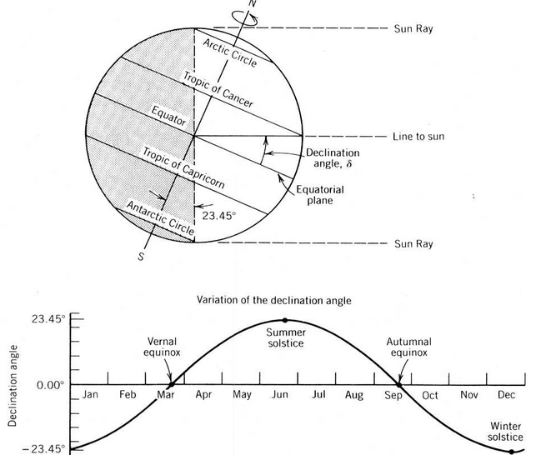

Slide 12
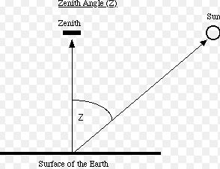
Zenith angle; Angle of incidence for a horizontal surface

Slide 13
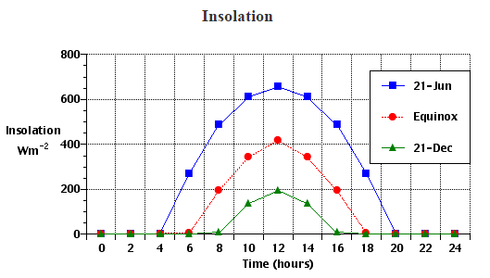
Daily variation:

Slide 14
Daily radiation:
At the Earth's surface quantities of insolation and net radiation undergo daily cycles of change because the planet rotates on its polar axis once every 24 hours.
Insolation is usually the main positive component making up net radiation.
Variations in net radiation are primarily responsible for the particular patterns of rising and falling air temperature over a 24 hour period.

Slide 15
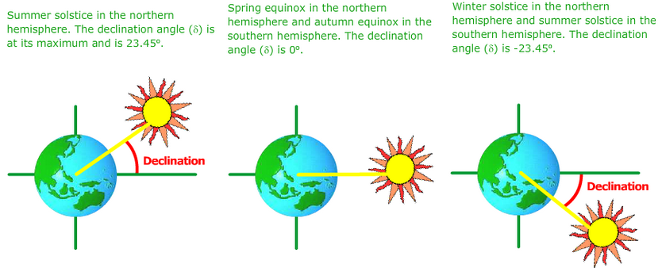

Slide 16
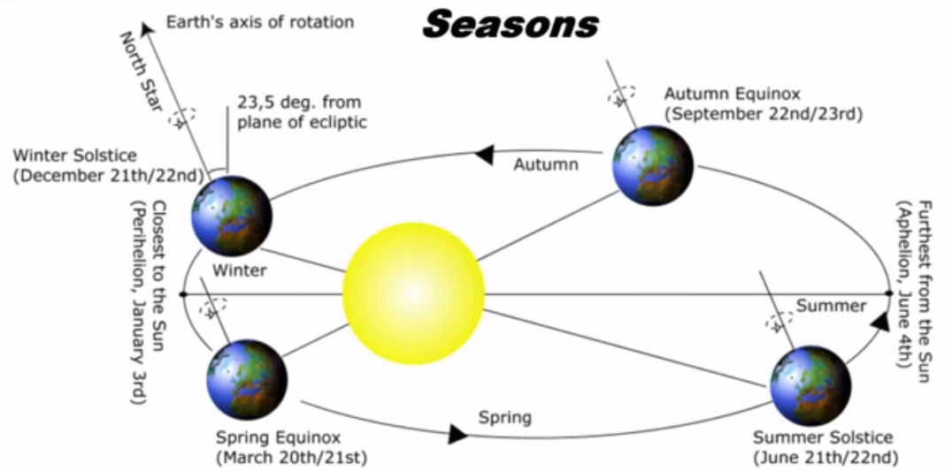

Slide 17
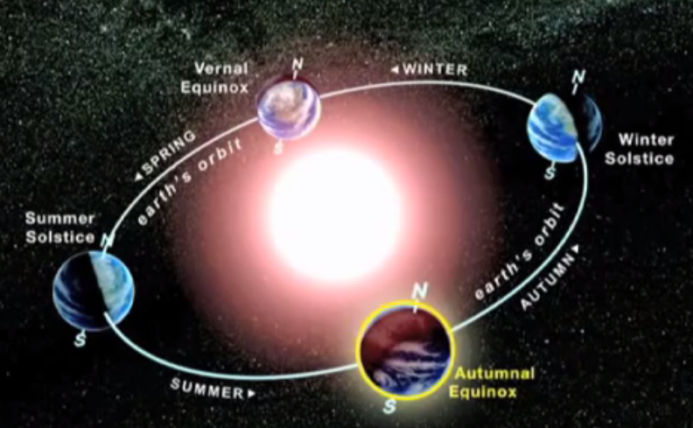

Slide 18
The Equinox represents the mid-way point between the two seasonal extremes. It occurs twice within the year - first on the 21st of March and again on the 21st of September.
At the Equinox the rays of solar radiation align with the Equator and are evenly distributed between the northern and southern hemispheres.
This date is also significant in that the hours of daylight are exactly equal to the hours of night
In June, the Earth's tilted rotation axis and position in it's orbit means that the northern hemisphere is more exposed to radiation from the Sun than the southern hemisphere.
In the northern hemisphere the Sun appears more overhead (ie: is at a higher altitude) and is visible for more hours of the day.
This effect is at it's peak on the 21st of June, which is the Summer Solstice in the northern hemisphere.
On the 21st of June in the Southern hemisphere the opposite is true. It is tilted further away from the Sun and is experiencing its Winter Solstice.
On 21st of December, which is the Winter Solstice in the northern hemisphere , Southern hemisphere experiencing Summer Solstice.

Slide 19
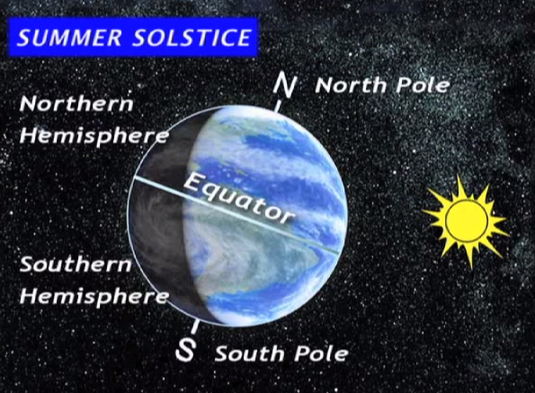

Slide 20
The Solar Window
The earth's rotation and revolution around the sun create a rectangular section through which your home receives direct sun all year
i.e. The Solar Window.

Slide 21
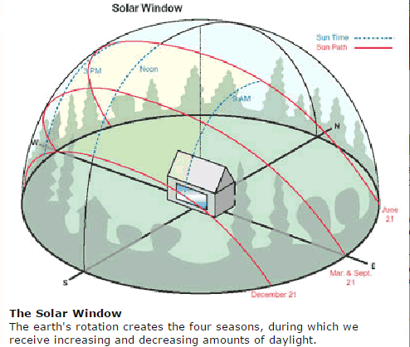

Slide 22
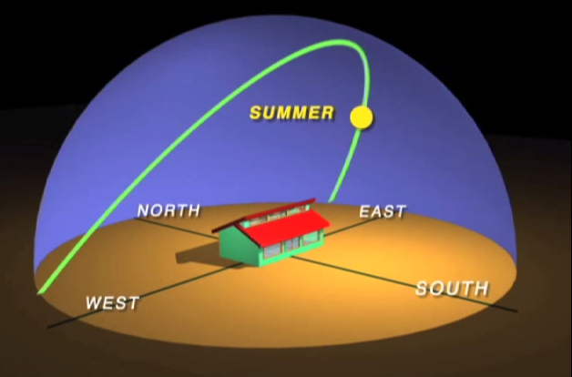

Slide 23
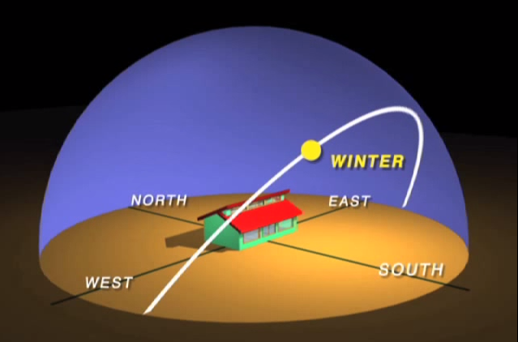

Slide 24
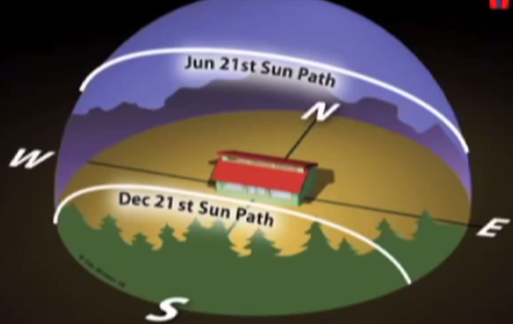

Slide 25
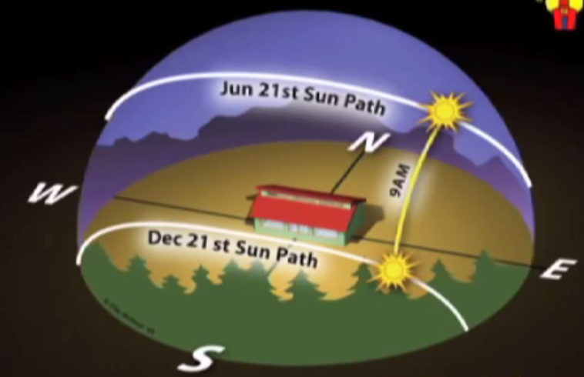

Slide 26
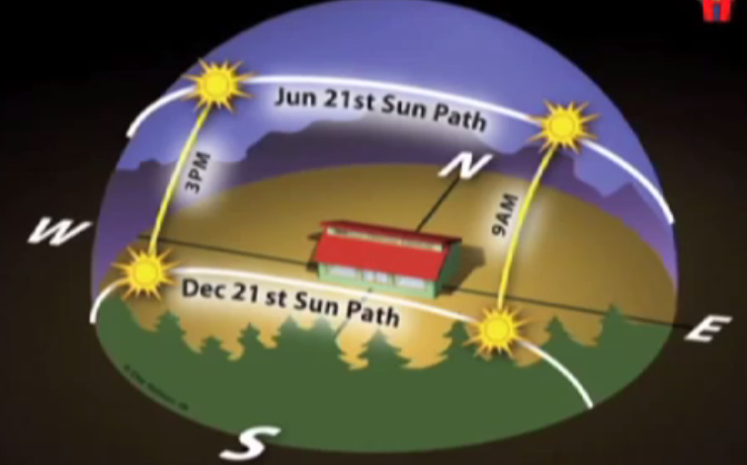

Slide 27
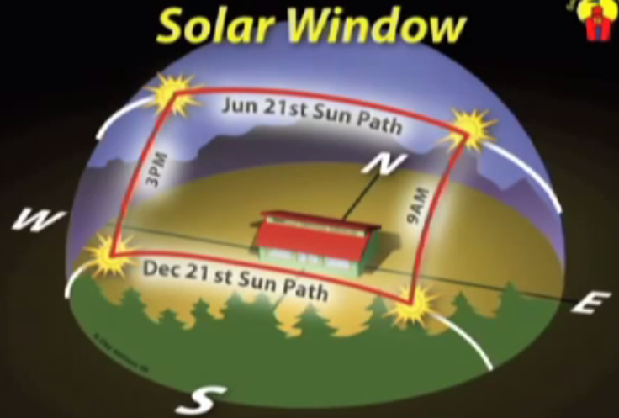

Slide 28
Solar window:
Sun moves in two planes:
Daily movement (9 AM to 3 PM)
Seasonal movement (Dec 21st to June 21st )
During the movement of the sun, the trees and tall structures have shadows.
The solar window is plotted on an imaginary spherical surface placed on the ground and with boundaries drawn by sectors corresponding to the
Path of Sun rays on 21st June
Path of Sun rays on 21st Dec
Path of Sun rays at 9AM
Path of Sun rays at 3 PM
Solar window is a useful tool to decide the location of the collector.

Slide 29
Declination angle(δ ):
The declination angle, denoted by δ, varies seasonally due to the tilt of the Earth on its axis of rotation and the rotation of the Earth around the sun.
The Earth is tilted by 23.45° and the declination angle varies plus or minus this amount.
Only at the spring and fall equinoxes is the declination angle equal to 0°.
The declination of the sun is the angle between the equator and a line drawn from the centre of the Earth to the centre of the sun.

Slide 30
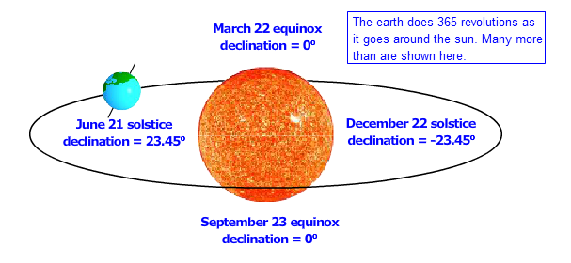

Slide 31
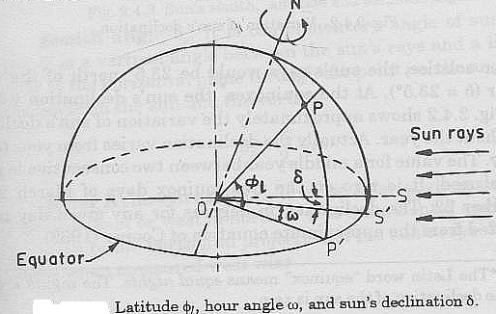
Angle of latitude for particular location on earth surface: angle between the line joining the location to the centre of earth and the equatorial plane. Declination angle δ: Angle between line joining sun to the earth and the equatorial plane,d = 23.45 * sin [360 / 365 * (284 + N)] The altitude фl of a point or location is the angle made by the radial line o the equatorial plane. .

Slide 32
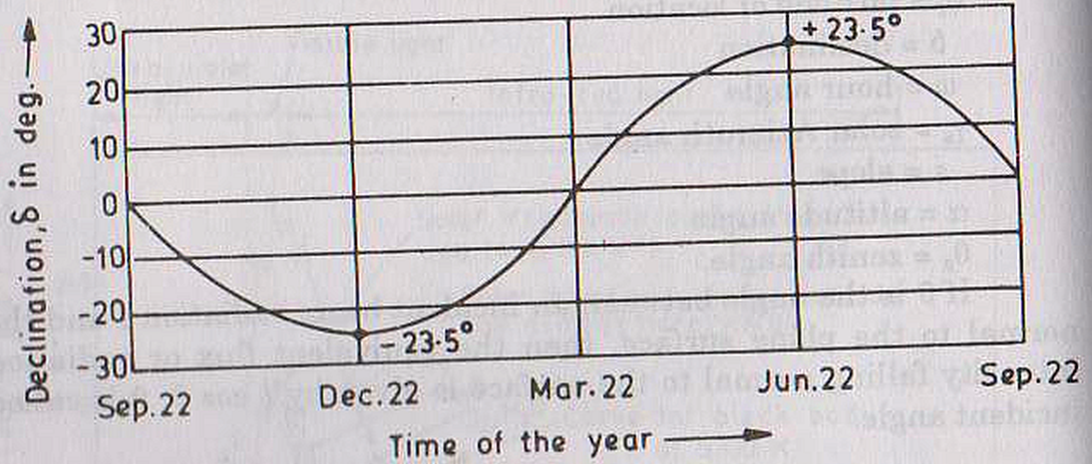
Variation of Sun’s declination

Slide 33
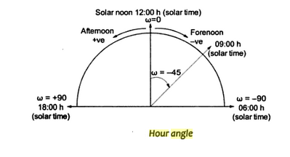
Hour angle: The angle representing the position of the sun with respect to clock hour and with reference to the sun’s position at 12 noon. The hour angle ω is equivalent to 15° per hour

